Slide 1
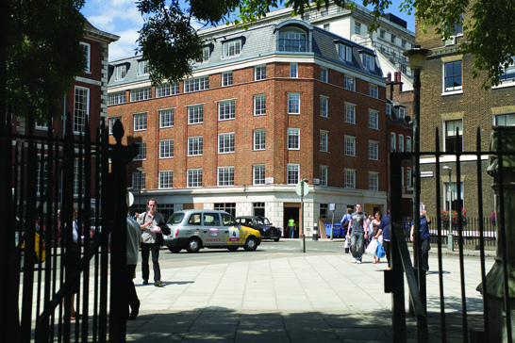
Welcome to the Centre for Commercial Law Studies (CCLS), Queen Mary University of London

Slide 2
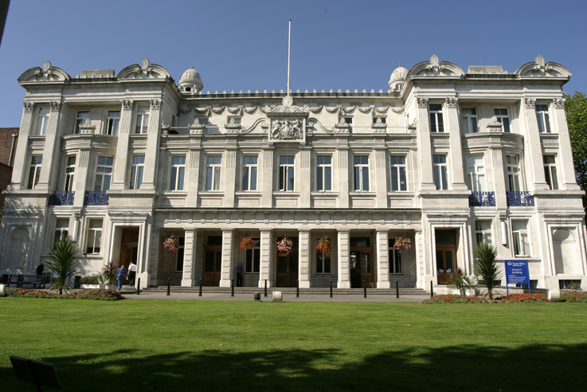
Overview
General Introduction
Location of CCLS, PG Law Centre
Programmes
Entry Requirements
Fees and Scholarships
Contacts

Slide 3
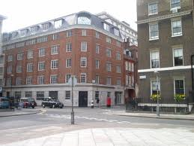
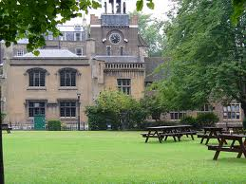
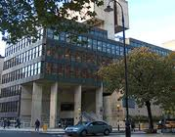
CCLS - Postgraduate Law Centre – Lincoln’s Inn Fields (LIF), Holborn
Charterhouse Square Campus
– Barbican
The Institute of Advanced Legal Studies (IALS) Library – Russel Square

Slide 4

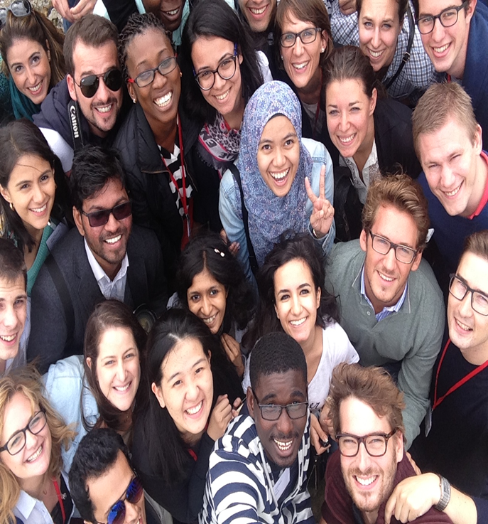
A few facts and figures….
Fantastic Diversity – LLM Students come from over 90 Jurisdictions, Queen Mary is also listed as top 25 the most international university in the world, welcomed students from 163 nationalities this year.
Ranked top 5 in UK for Law (Guardian University Guide 2016)
School of Law – CCLS & Department of Law - over 100 academics
Offers the largest LLM Programmes in the UK (700-800 students per year)
QS Worldwide 35 (QS World University Guide 2016)
LLM students at their Induction

Slide 5
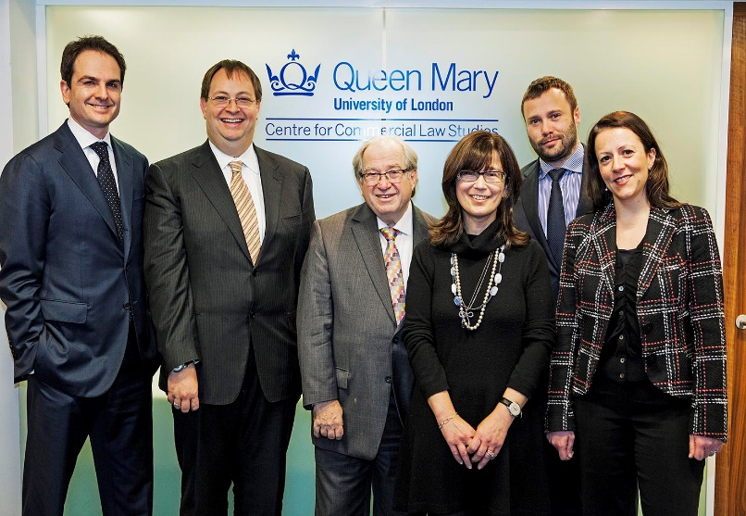
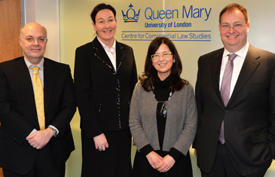
Specialisms Examples
School of International Arbitration (SIA)
  Conducts world leading research, has a global reputation and works closely with PWC, White & Case LLP etc.; Established in 1985, just marked the 30th Anniversary of the SIA in 2015.
  Large, dedicated Alumni Network – regularly hold conferences in UK and overseas
Energy and Natural Resources Law Institute
  Internships just for QMUL students from LLM in Energy and Natural Resources Law; regular high profile guest speakers – e.g Andrew Clarke, General Counsel, Esso UK Ltd.

Slide 6
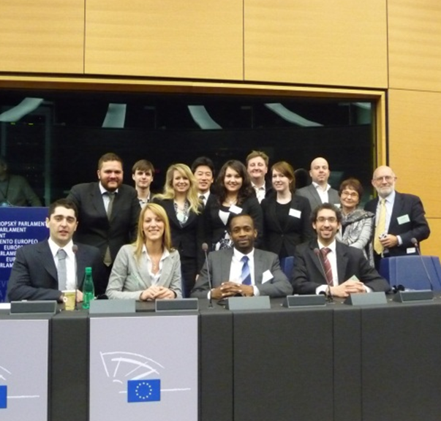
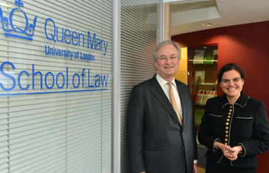
Specialisms Examples
  Queen Mary Intellectual Property Research Institute (QMIPRI)
World renowned reputation in IP, patents and trade marks, offers extensive range of very specialist modules inc., fashion, medicine, technology, arbitration etc.
Annual visits arranged for the best PGT IP students to IP forums in Alicante, Strasbourg, Munich
  Institute of Banking and Finance Law,
  Institute of Global Law, Economics and Finance
Distinguished professors regularly advise or be invited to give guest lectures;
Close links with Bank of England, International Monetary Fund, World Bank, European Central Bank, National and International Governments and Banks
PG law IP students and staff, Strasbourg
Professor Rosa Lastra with Graham Nicholson,
Bank of England

Slide 7
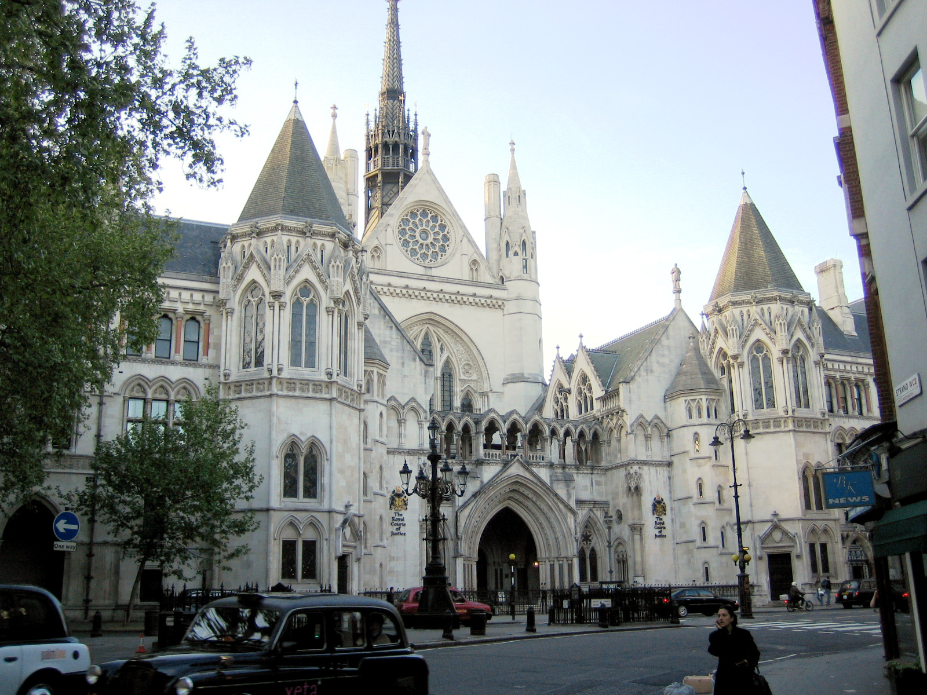
London LLM (Master of Laws) – 22 pathways
Banking and Finance Law
Commercial and Corporate Law
Comparative and International Dispute Resolution
Competition Law
Computer and Communications Law
Criminal Justice
Energy and Natural Resources Law
Environmental Law
European Law
General Law
Human Rights Law
Immigration Law
Insurance Law
Intellectual Property Law
International Business Law
International Economic law
International Shipping Law
Legal Theory
Media Law
Medical Law
Public International Law
Tax Law

Slide 8
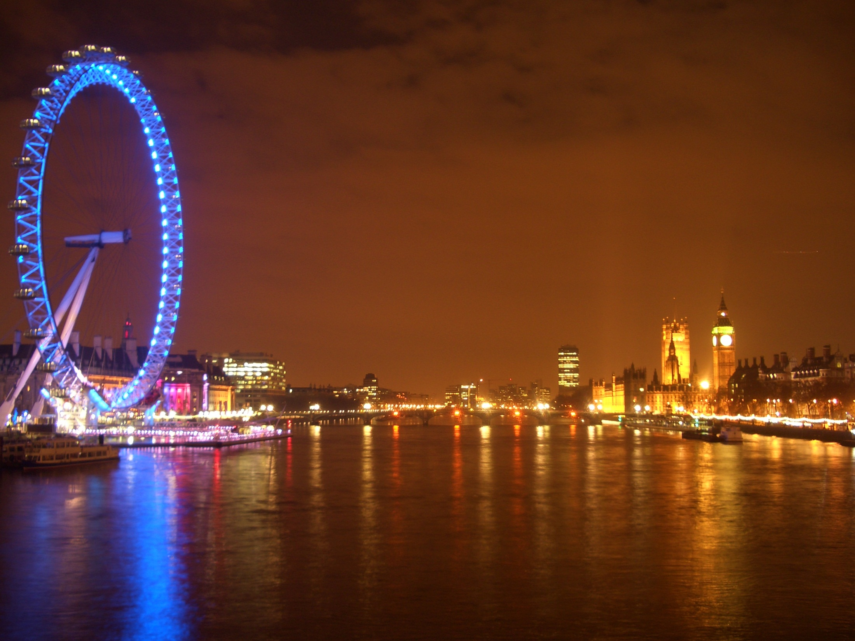
Key times of the LLM Programmes
Enrolment/Induction – Mid-late September (2 weeks)
LLM module registration process completed by mid October
First Term – First week of October to mid December
Submit dissertation proposal outline by mid-late November
Second Term -2nd week of January to 3rd week of March
Revision – April
Exam Period – Between end of April and beginning of June
Dissertation submission – Early-mid August
Results being confirmed by early November
Graduation – Early-mid December

Slide 9



MSc in Law and Finance
Taught jointly by CCLS and the School of Economics and Finance
Students choose one of the following pathways:
  MSc in Law and Finance – Main Stream
  Banking and Financial Services
  Law and Financial Regulation
  Law and Corporate Finance
  Islamic Finance
  Compliance in the Global Markets
Professional Exams Exemptions

Slide 10

LLM in Law and Economics
Taught jointly by CCLS and the School of Economics and Finance
Aim: Use theoretical and applied economic analysis to analyse the law and the legal framework
Jurisprudence Pathway
Economic Pathway
Broad range of LLM modules including: Arbitration, Banking, IP, Tax, Trade
Broad range of Economics modules including: Micro/Macro, Behavioural Finance, Labour Economics

Slide 11
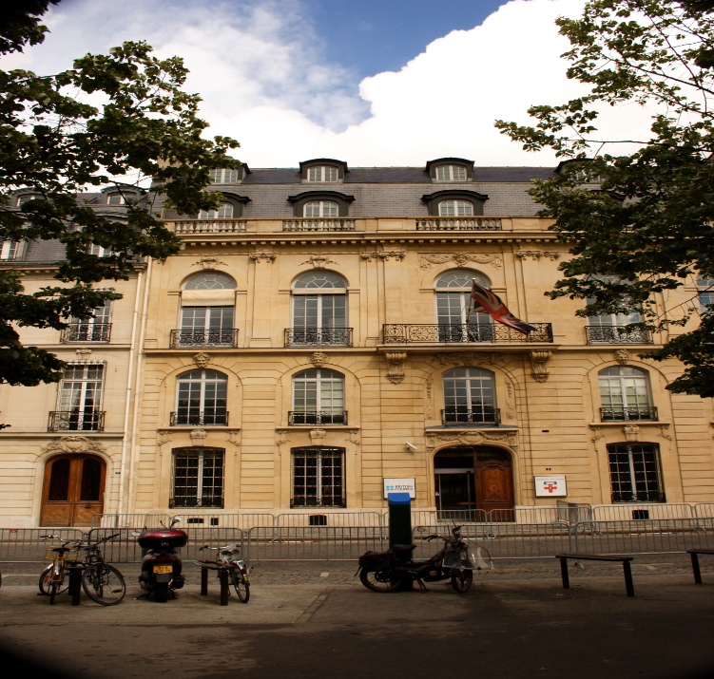
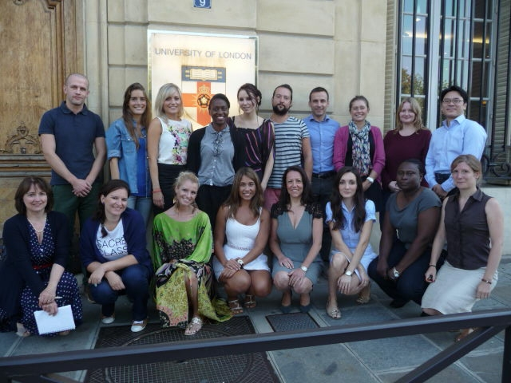
LLM Paris Programme
Taught in Central Paris – at the University of London Institute in Paris (ULIP), located near Eiffel Tower
LLM in International Business Law – Main Programme
Other pathways available:
LLM in Banking and Finance Law
LLM in International Dispute Resolution and Economic Law
LLM in Intellectual Property Law
LLM in Energy and Natural Resources Law
Block teaching or evening mode – Full Time or Part Time, especially suitable for busy professionals
January or September Start Dates
Taught in English
Academic legal English support available

Slide 12
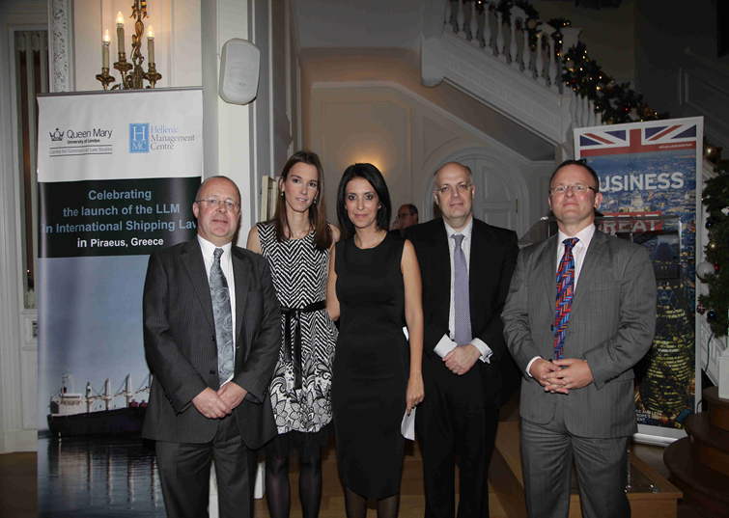

  LLM in International Shipping Law
Taught in Hellenic Management Centre (HMC), Piraeus, Greece
Evening/weekends intensive block teaching
Delivered by CCLS academics in English
Accredited by the Institute of Chartered Shipbrokers
Programme Launch Party held at the British Embassy, Athens, Greece.
L-R:
Vice Principal (International) Queen Mary University Of London, Professor David Sadler; Programme Director Dr Tina Loverdou;
Director of HMC, Ms Natalia Margioli;
Director of CCLS, Professor Spyros Maniatis;
The British Ambassador Mr. John Kittmer

Slide 13
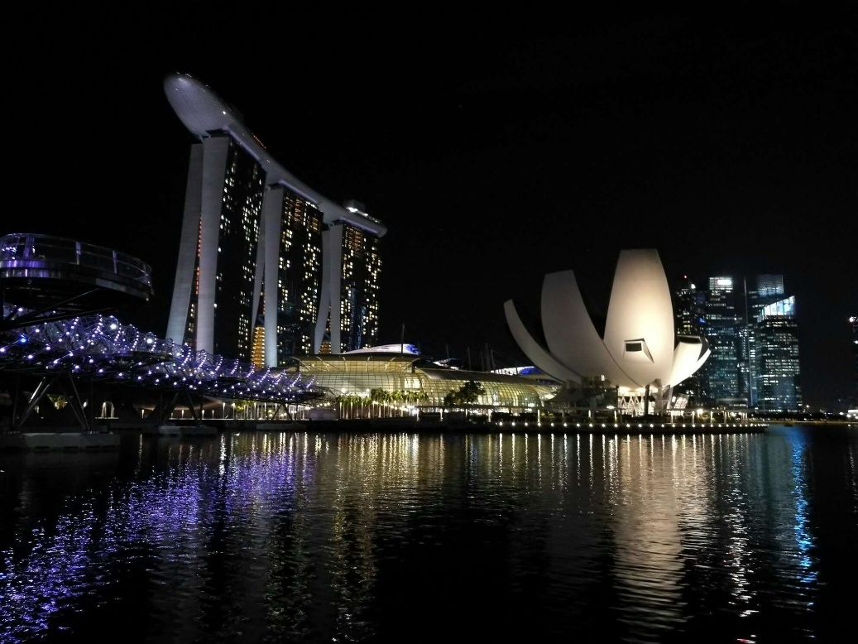
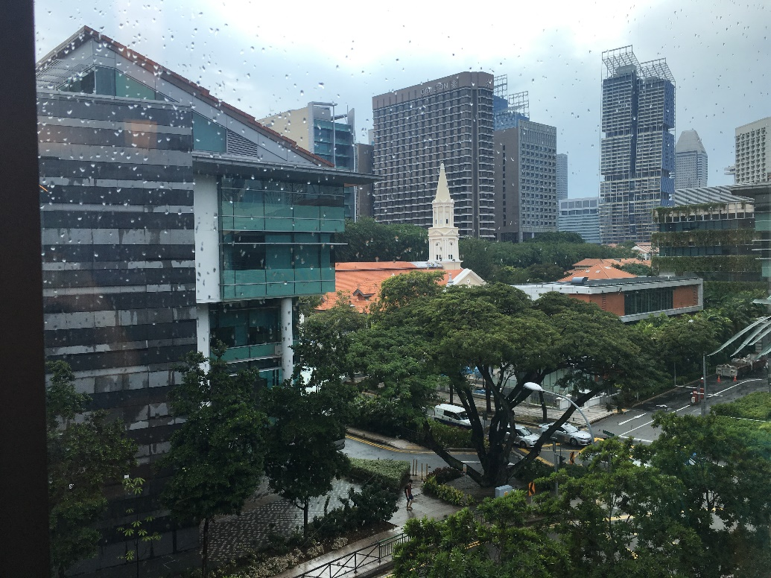
  Dual LLM in Commercial Law (Singapore and London)
Taught in two cities – Singapore and London
Delivered by both SMU and CCLS/QMUL academics
Provides an expert and in-depth understanding of the workings of commercial Law and the application of the law to everyday practice.
One programme, two degrees within 15 months

Slide 14
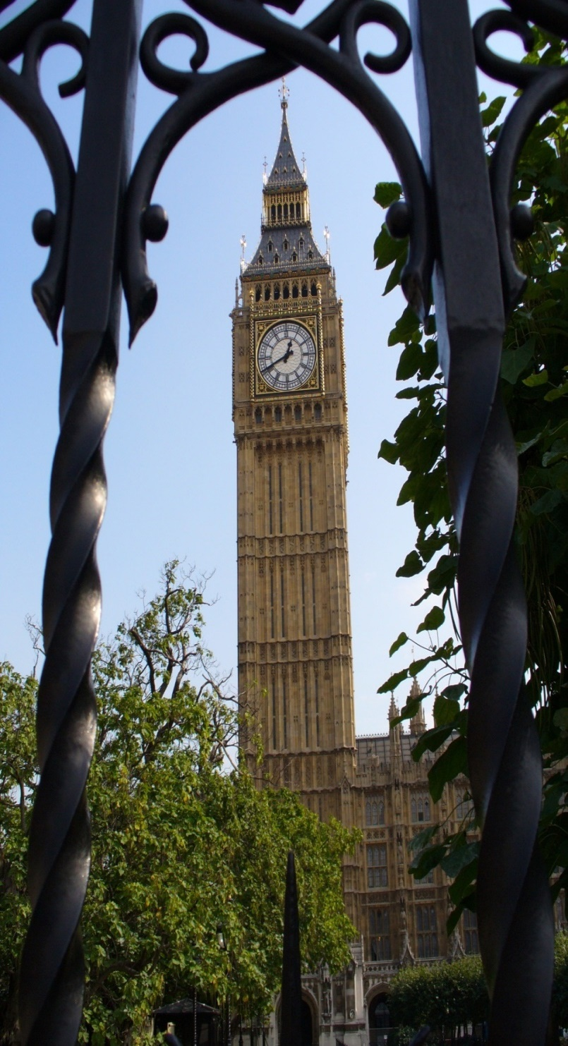
Minimum Academic & English Language Entry Requirements
We consider every application on an individual basis
For the majority of our PG taught Law programmes – we accept 2.1 law degree or above, which is equivalent to Four-year Bachelors/Juris masters from recognised Universities – scores between 75% and 85% depending on the university
English
For Taught Masters IELTS – 7 (Inc. 7 in writing) or ILEC (C1)
http://www.qmul.ac.uk/international/international-students/englishlanguagerequirements/guidelines/index.html

Slide 15
Pre-Sessional English - 1
Key: R = Reading, L = Listening, S = Speaking, W = Writing
Programme | IELTS* | ILEC
English entry requirements No Pre-Sessional required | 7.0 (minimum Writing: 7.0 and R, L, S: 5.5) | C1
In-sessional programme required | 7.0 (minimum Writing: 6.5 and R, L, S: 5.5)
Five-week Pre-Sessional In-sessional programme required | 6.5 (minimum Writing:6.5 and R, L, S: 5.5)
Nine-week Pre-Sessional In-sessional programme required | 6.5 (minimum Writing: 6.0 and R, L, S: 5.5) | B2
Thirteen-week Pre-Sessional In-sessional programme required | 6.0 (minimum W, R, L, S: 5.5)
6.5 or below in the IELTS Writing component (or equivalent) is required to attend the Queen Mary in-sessional Critical Thinking and Writing in Law Programme; this is free to QM students. Students who achieve IELTS 5.5 or below (or equivalent) are not normally admitted onto the Pre-Sessional Programme.
Pre-Sessional Classes take place every weekday, from 9am - 4pm in the following format:
Interactive Seminars
Lectures
Individual Tutorials

Slide 16
Pre-Sessional English - 2
Dates for Summer Pre-Sessional Programmes 2016*
Course | Dates | Fees | Deadline for applications
13-week programme | 16th June to 14th September 2016 | £4,600 | applications close on the 5th June 2016
9-week programme | 14th July to 14th September 2016 | £3,200 | applications close on the 2nd July 2016
5-week programme | 11th August to 14th September 2016 | £2,050 | applications close on the 30th July 2016
* Prices and dates based on 2016 programmes. Updates to 2017 programmes will be updated on the website
90% of Pre-Sessional students progress to their degree programmes at Queen Mary
The end-of-programme assessments are accepted by the UKVI; consequently students do not
need to sit an IELTS or other Secure English Language Test.

Slide 17
Why do an LLM or PG Taught Law Masters?
Provides academic rigour
Focuses on the specialist language of the law
Enables students to communicate effectively in their chosen specialism
Offers a broader context to provide meaningful and practical skills to develop your career
Enhances employability
Creates excellent networking opportunities with leading experts within industry
Important Note:
An LLM or MSc does NOT qualify you to practice law in England or Wales
(Careers support staff can provide assistance on options to qualify after LLM)

Slide 18

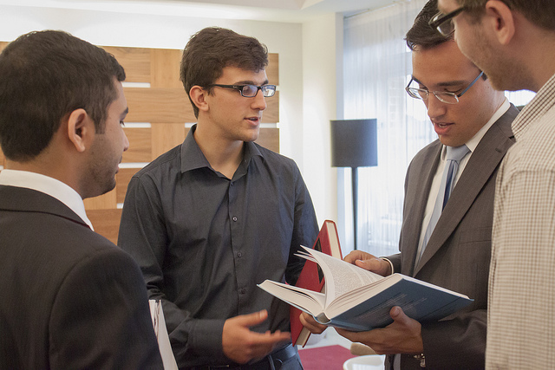
Central support available to students
Careers Support
Advice and Counselling Service
Residences Office
Library
Student Union

Slide 19
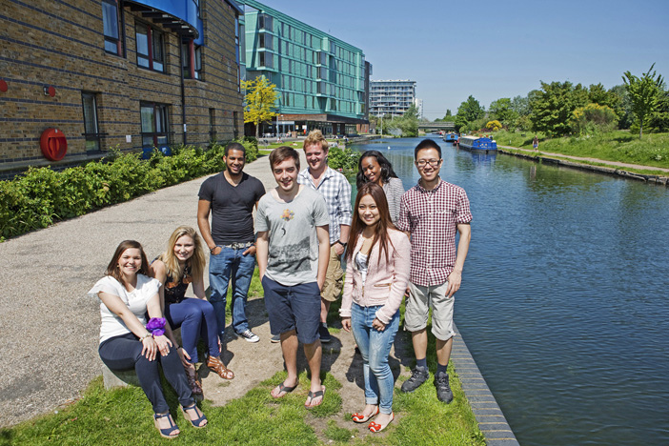
Critical Thinking and Writing in Law(In-Sessional)
Open to all students following LLM modules – no extra charge
Developing or enhancing performance in academic thinking and writing
All students offered assistance with:
  Planning and structuring their exam answers and course essays
  Research methodology
  Developing proposals into well-structured dissertations

Slide 20
Scholarships/Funding Opportunities
All programmes have full/partial scholarships available to students until the beginning of June or later
More funding opportunities can be found via the link below around November each year for entries in the following academic year:
http://www.law.qmul.ac.uk/postgraduate/funding/index.html

Slide 21
Tuition Fees 2016/17 for International Students
full-time Study
LLM – Master of Laws and 22 pathways
LLM in Law and Economics All £18,950
MSc Law and Finance
LLM in International Shipping Law (Piraeus, Greece)
LLM in Paris
Dual LLM in Commercial Law (Singapore and London) – 15 months
£28,000
Students joining eligible CCLS programmes from partnerships institutions are entitled to 10% tuition fees discounts

Slide 22
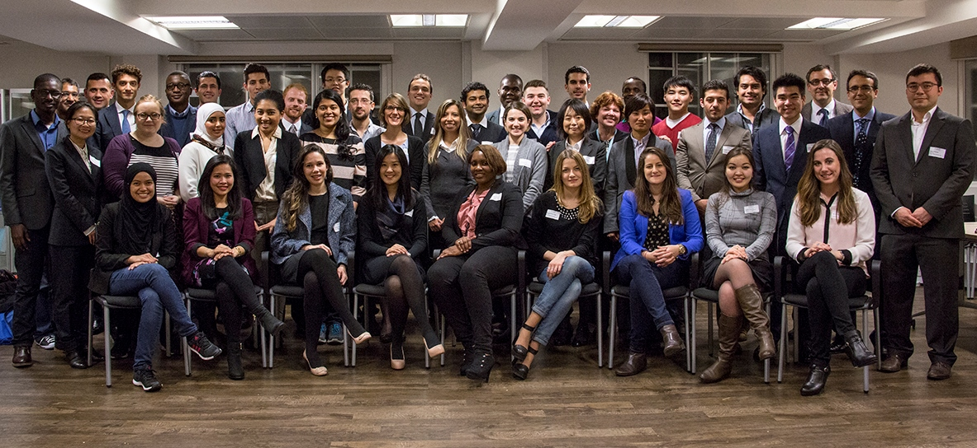
Tuition Fees and Scholarships
PG School of Law, CSC, Commonwealth, Chevening, Jean Monnet and Sponsored Scholarship Winners & QMUL Law Staff 2014-15
Notes:
2010-11 Scholarship students

Slide 23
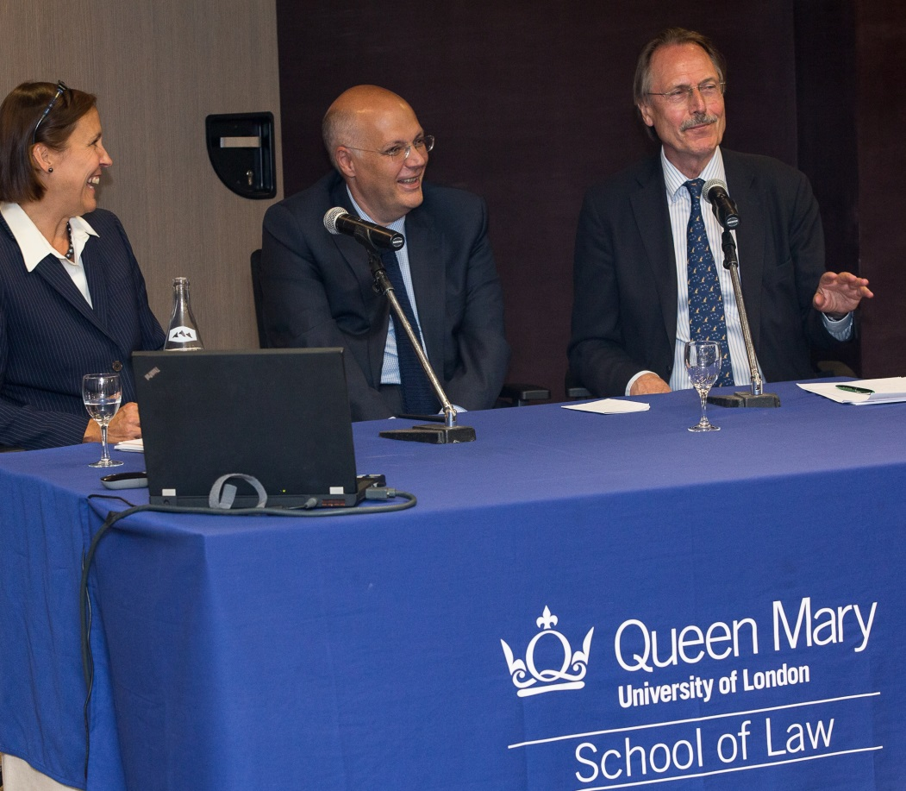
Careers & Networking Opportunities
Careers support staff and academics organise regular talks by leading law firms & institutions including:
  Allen & Overy
  Linklaters
  Clifford Chance
  Herbert Smith
  Freshfields
  Bird & Bird
  Bank of England
  Federal Reserve Bank of NY
  IMF
  Bloomberg
  Field Fisher Waterhouse
  Preiskel & Co
L-R - Partner from McDermott Will & Emery, US office;
HoD of CCLS, German IP Judge
September 2014, Opening Lecture for the LLM in Paris

Slide 24








Internship Opportunities Unique for QMUL PG Law Students
CLIFFORD CHANCE

Slide 25
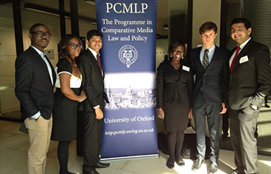
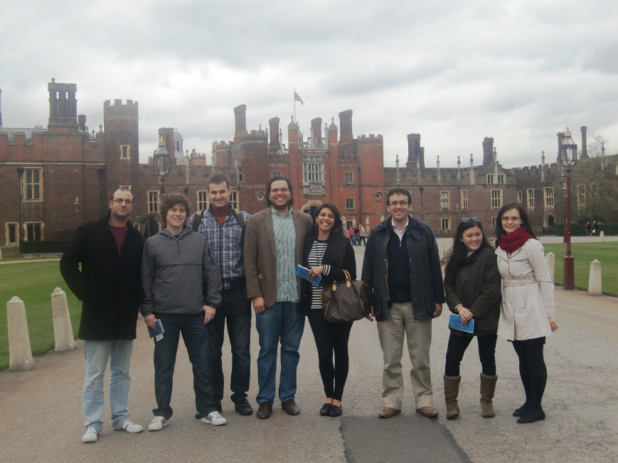
Support for Mooting, Enjoying the London Life…..
Academic support to prepare for….
Oxford University's Price Media Law International Moot Court
Willem C Vis International Arbitration Moot
IP Moot at Oxford University
LLM students got to the last 4 teams in the Oxford IP Moot in 2014
MSc in Law and Finance students and Prof Rodrigo Olivares-Caminal in Hampton Court

Slide 26
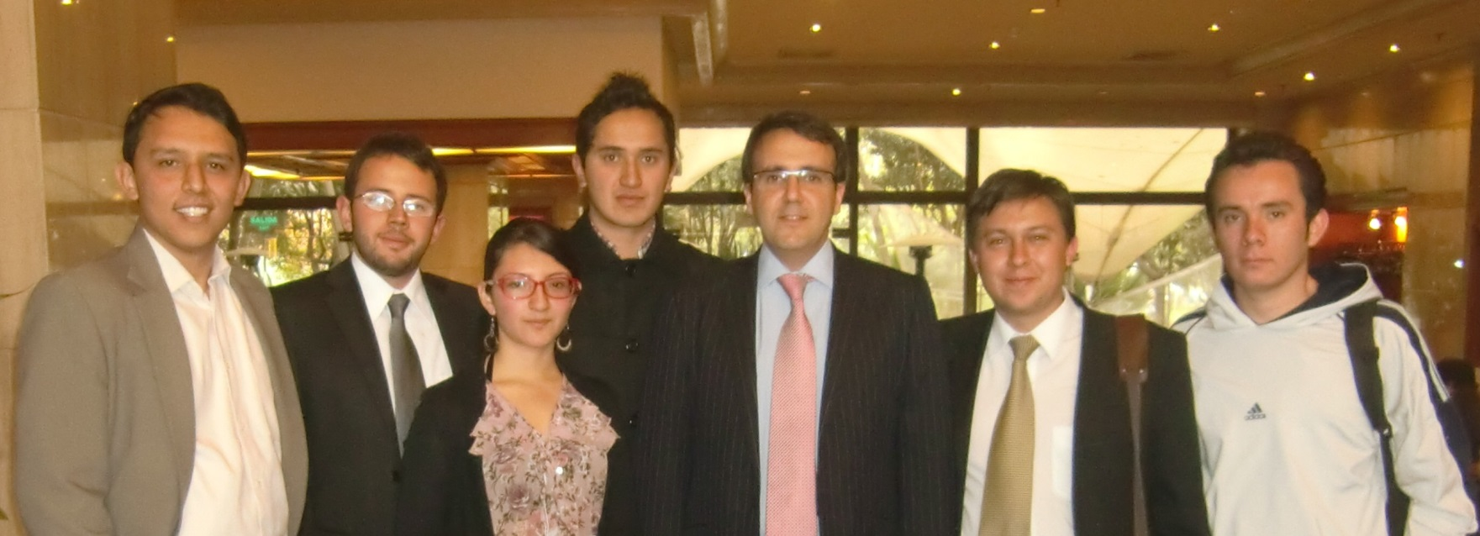
QMUL collaborating with Nacional – QM LLM IP Alumnus German Florez September 2013 – Moot competition
Prof Rodrigo Olivares - Caminal (centre) next to German Florez, QMUL LLM IP Alumnus

Slide 27
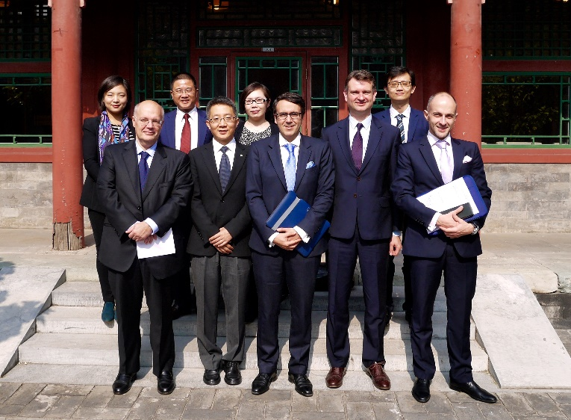
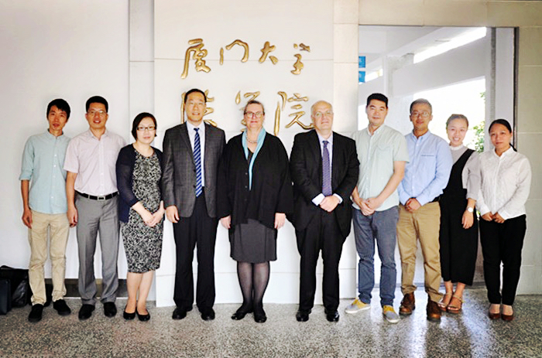
China Specific Collaborations
  Beijing Foreign Studies University
  Beijing Arbitration Commission
  China Intellectual Property Training Centre
  City University of Hong Kong
  East China University of Political Science and Law
  EU-China Initiative – IP KEY
  Great Britain China Centre
  Peking University
  Renmin University
  Shanghai Bar Association
  Shanghai University of Finance and Economics
  State Intellectual Property Office
  Tsinghua University
  University of International Business and Economics
  Xiamen University

Slide 28
Contact Us….
Office in East Asia
E-Mail: china-students@qmul.ac.uk
Tel: +86-10-57306031/39
WeChat: QueenMaryLondon
Weibo: weibo.com/QMUL
International Partnerships Team
Email:international-partnerships@qmul.ac.uk
Other contacts can be found via the link below:
http://www.law.qmul.ac.uk/people/support/index.html

Slide 29
http://www.law.qmul.ac.uk/postgraduate/index.html

